Slide 1

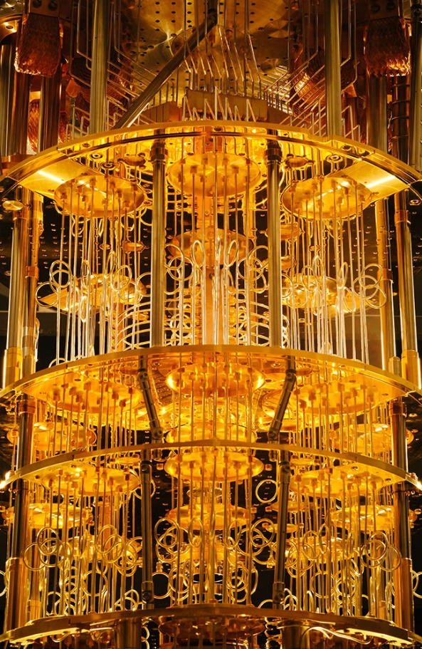
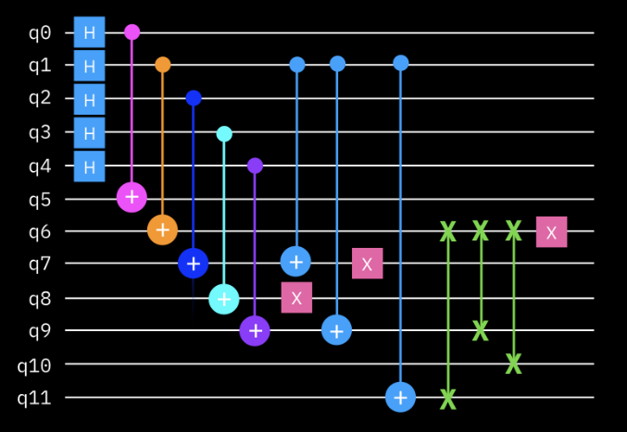
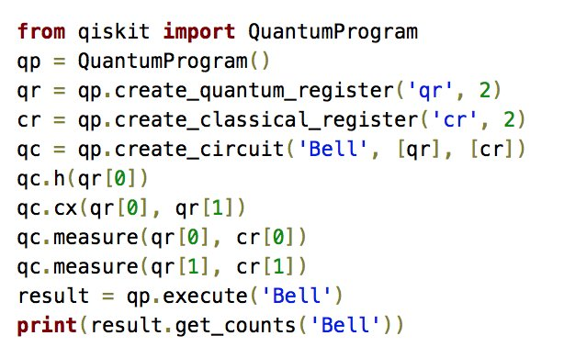
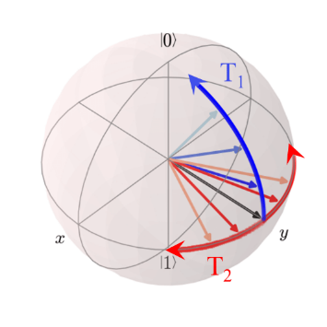

Foundations of
Quantum Information Science (QIS 101)
Dave Biersach
Brookhaven National Laboratory
dbiersach@bnl.gov
Session 10
Numerical
Analysis

Slide 2
Session 10 – Goals
Numerically compute and plot the first derivative of a function using Fermat's Difference Quotient
Derive Simpson's Rule for numerical integration and compare this to the accuracy of the left-hand rule
Consider the advantages an adaptative quadrature approach may realize versus fixed width intervals
Leverage the SciPy Integration sub-package and compare its accuracy to our fixed-width Simpson's Rule implementation
Numerically integrate the Probability Density Function (PDF) of the Gaussian Standard Normal distribution

Slide 3
Session 10 – Goals
Numerically estimate Dirichlet's pathological function and appreciate that nowhere continuous functions may have a Lebesgue Integral
Use the SciPy Optimization sub-package to numerically locate the global minima of a trigonometric function
Calculate the arc length of Archimedes' Spiral
Extrapolate the divergence of the Harmonic Series using Euler's Constant

Slide 4
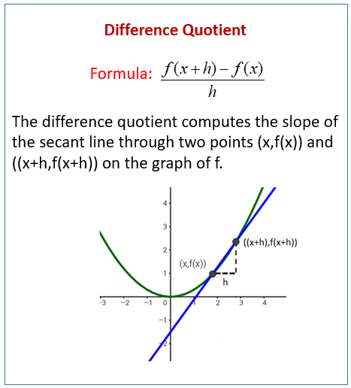
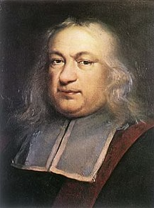

Numerical Differentiation
Your scientist has asked you to numerically compute the first derivative of $f\left(x\right)=\cos{x}$ and to plot $f\left(x\right)$ and $f^{′}\left(x\right)$ across the interval $−4π≤x≤4π$
Pierre de Fermat
1607-1665

Slide 5
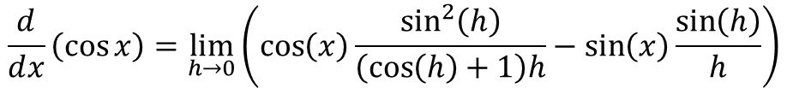



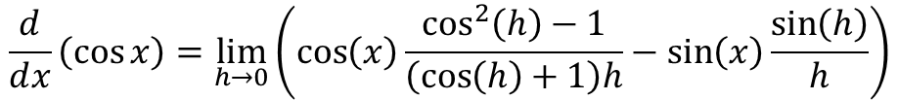
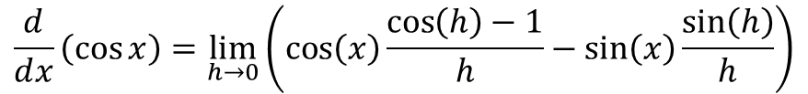

Derivative of $\cos{x}$
$$\frac{d}{ⅆx}\left(\cos\left(x\right)\right)=\lim_{h→0}{\frac{\cos\left(x+h\right)−\cos\left(x\right)}{h}}$$
Angle Sum Identity
$$\frac{d}{ⅆx}\left(\cos{x}\right)=\lim_{h→0}{\frac{\left(\cos\left(x\right)\cos\left(h\right)−\sin\left(x\right)\sin\left(h\right)\right)−\cos\left(x\right)}{h}}$$
Collect like terms
$$\frac{d}{ⅆx}\left(\cos{x}\right)=\lim_{h→0}\left(\cos\left(x\right)\frac{\cos\left(h\right)−1}{h}−\sin\left(x\right)\frac{\sin\left(h\right)}{h}\right)$$
Multiply By:
$$\frac{\cos\left(h\right)+1}{\cos\left(h\right)+1}$$
$$\frac{d}{ⅆx}\left(\cos{x}\right)=\lim_{h→0}\left(\cos\left(x\right)\frac{\cos^{2}\left(h\right)−1}{\left(\cos\left(h\right)+1\right)h}−\sin\left(x\right)\frac{\sin\left(h\right)}{h}\right)$$
$$\sin^{2}{h}+\cos^{2}{h}=1$$
$$\frac{d}{ⅆx}\left(\cos{x}\right)=\lim_{h→0}\left(\cos\left(x\right)\frac{\sin^{2}\left(h\right)}{\left(\cos\left(h\right)+1\right)h}−\sin\left(x\right)\frac{\sin\left(h\right)}{h}\right)$$

Slide 6
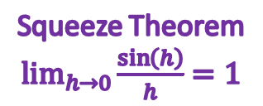
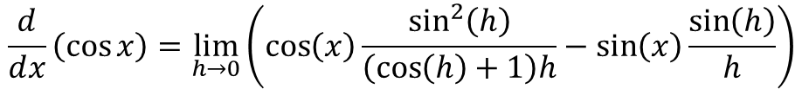
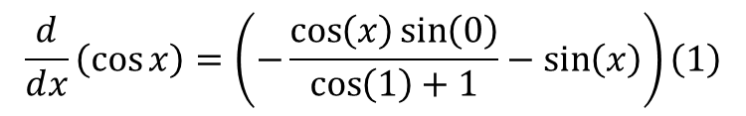
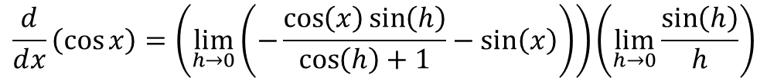

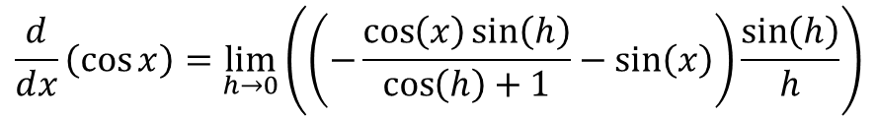

Derivative of $\cos{x}$
$$\frac{d}{ⅆx}\left(\cos{x}\right)=\lim_{h→0}\left(\cos\left(x\right)\frac{\sin^{2}\left(h\right)}{\left(\cos\left(h\right)+1\right)h}−\sin\left(x\right)\frac{\sin\left(h\right)}{h}\right)$$
Factor out$\frac{\sin\left(h\right)}{h}$
$$\frac{d}{ⅆx}\left(\cos{x}\right)=\lim_{h→0}\left(\left(−\frac{\cos\left(x\right)\sin\left(h\right)}{\cos\left(h\right)+1}−\sin\left(x\right)\right)\frac{\sin\left(h\right)}{h}\right)$$
Limit of product is product of limits
$$\frac{d}{ⅆx}\left(\cos{x}\right)=\left(\lim_{h→0}\left(−\frac{\cos\left(x\right)\sin\left(h\right)}{\cos\left(h\right)+1}−\sin\left(x\right)\right)\right)\left(\lim_{h→0}{\frac{\sin\left(h\right)}{h}}\right)$$
Squeeze Theorem $\lim_{h→0}{\frac{\sin\left(h\right)}{h}}=1$
$$\frac{d}{ⅆx}\left(\cos{x}\right)=\left(−\frac{\cos\left(x\right)\sin\left(0\right)}{\cos\left(1\right)+1}−\sin\left(x\right)\right)\left(1\right)$$
$$\frac{d}{ⅆx}\left(\cos{x}\right)=−\sin\left(x\right)$$

Slide 7
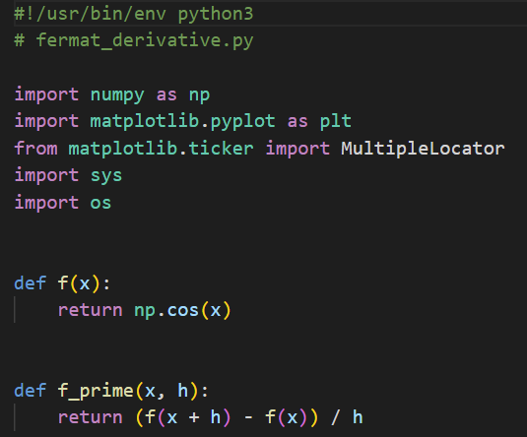
Open fermat_derivative.py
①
②
③
④
⑤

Slide 8
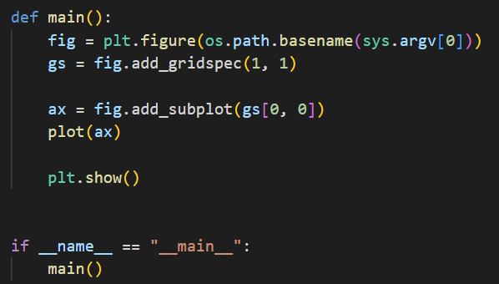
View fermat_derivative.py
③
④
⑤
⑥
⑦
①
②

Slide 9
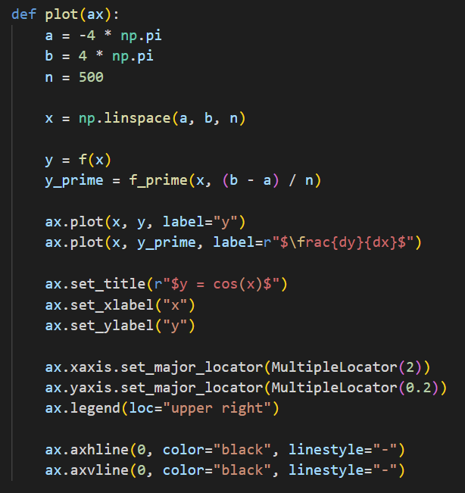
View fermat_derivative.py
①
②
③
④
⑤
⑥
⑦
⑧
⑨
⑩

Slide 10
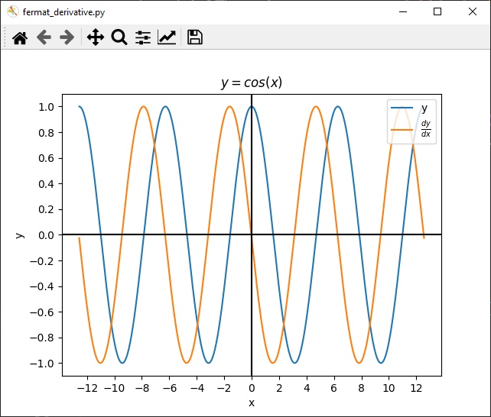


Run fermat_derivative.py
$$f\left(x\right)=\cos{x}$$
$$f^{′}\left(x\right)=−\sin{x}$$

Slide 11
Why do we need integrals?
How to calculate the total change in a variable X
When variable X depends on the changes in variable Y…
… and variable Y depends on the changes in variable Z…
… and variable Z is constantly changing…
Think about an accelerating car and the total distance it will travel in each number of seconds
The total distance depends on the velocity of the car…
… the velocity of the car depends on the acceleration
… and the acceleration is constantly changing

Slide 12
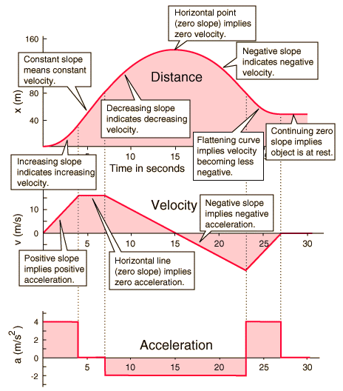
Why do we need integrals?

Slide 13
Why do we need integrals?

Slide 14
Why do we need integrals?
s
s
Differentiate
v
v
Integrate
a
a

Slide 15
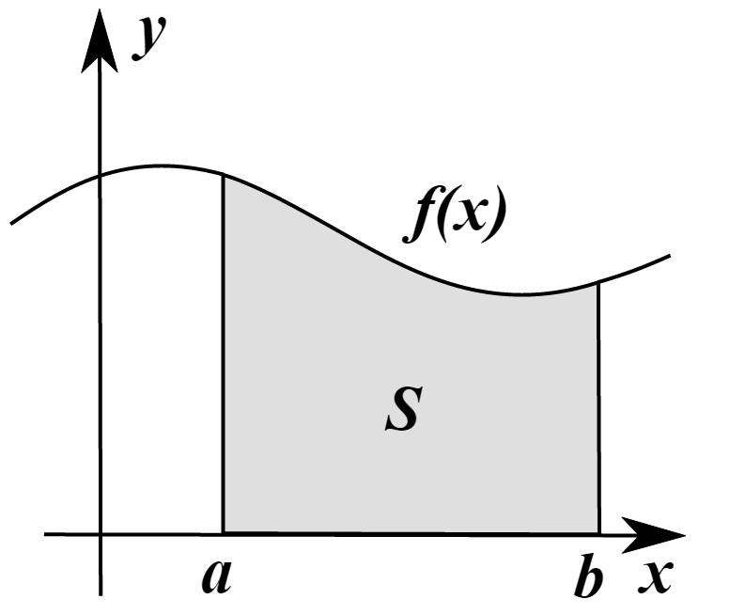
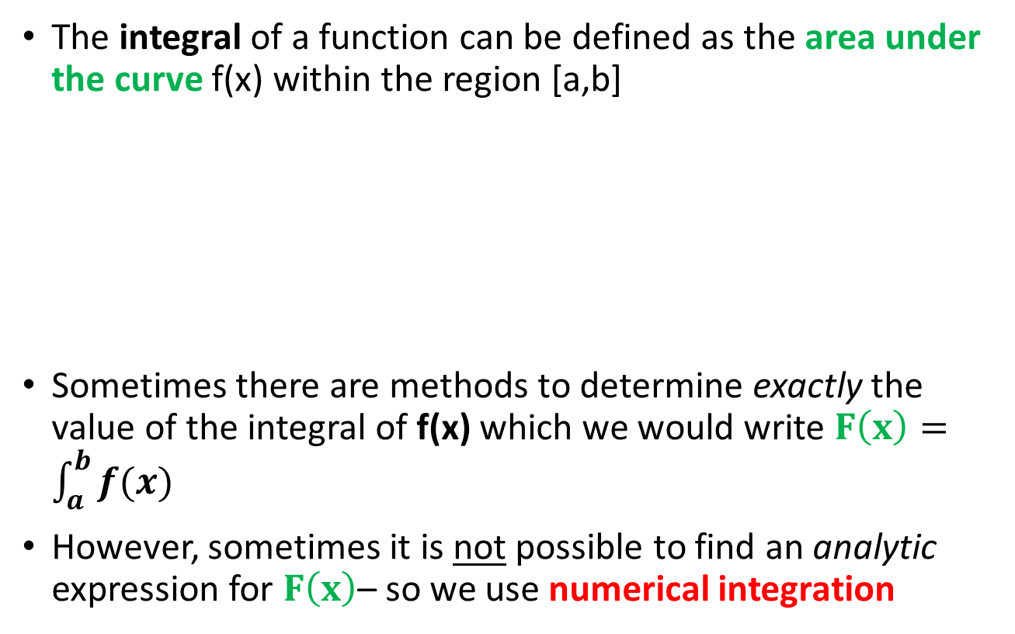
Why do we need integrals?
The integral of a function can be defined as the area under the curve f(x) within the region [a,b]
Sometimes there are methods to determine exactly the value of the integral of f(x) which we would write $F\left(x\right)=\int_{a}^{b}{f(x)}$
However, sometimes it is not possible to find an analytic expression for $F\left(x\right)$– so we use numerical integration

Slide 16
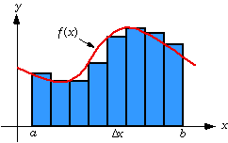
Riemann Sums
One way we can integrate f(x) is to divide the area under the curve into strips (intervals) and sum the area of each strip
This estimate may not be totally accurate because we might have gaps between the true value of f(x) and the top of a strip

Slide 17
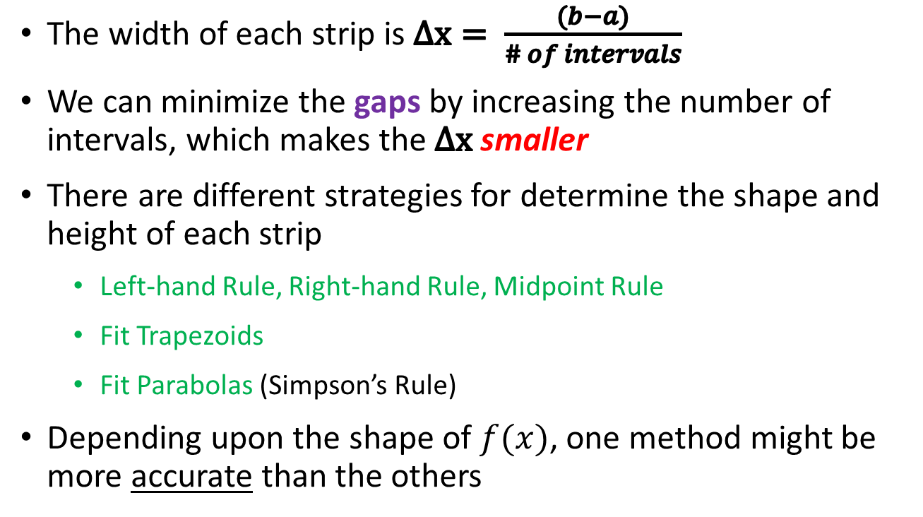
Riemann Sums
The width of each strip is $Δx= \frac{(b−a)}{\# of intervals}$
We can minimize the gaps by increasing the number of intervals, which makes the $Δx$ smaller
There are different strategies for determine the shape and height of each strip
Left-hand Rule, Right-hand Rule, Midpoint Rule
Fit Trapezoids
Fit Parabolas (Simpson’s Rule)
Depending upon the shape of $f(x)$, one method might be more accurate than the others

Slide 18
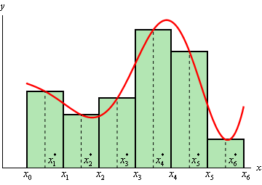
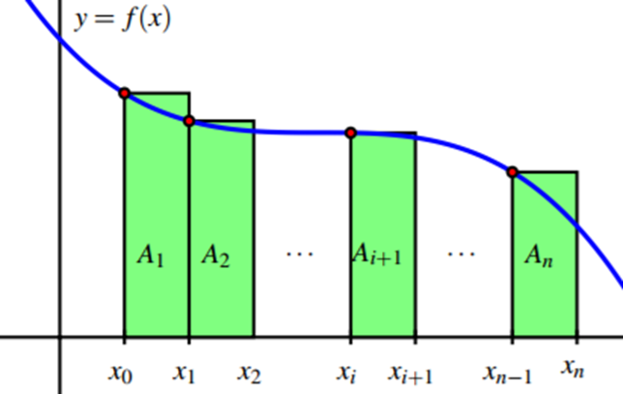
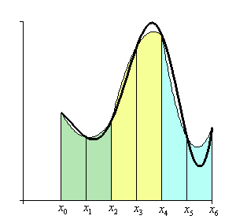
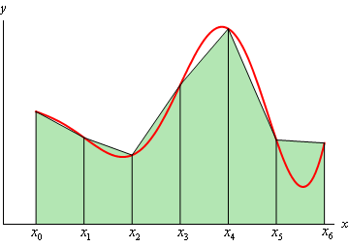
Riemann Sums
Left-Hand
Midpoint
Trapezoids
Parabolas
(Simpson’s Rule)

Slide 19
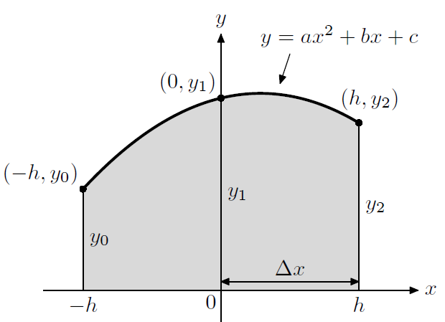
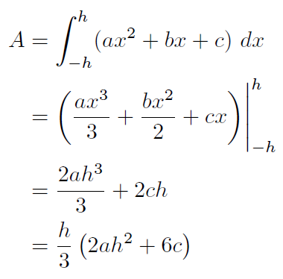

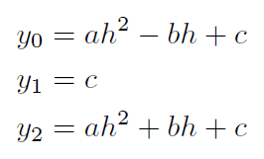
Deriving Simpson’s Rule

Slide 20
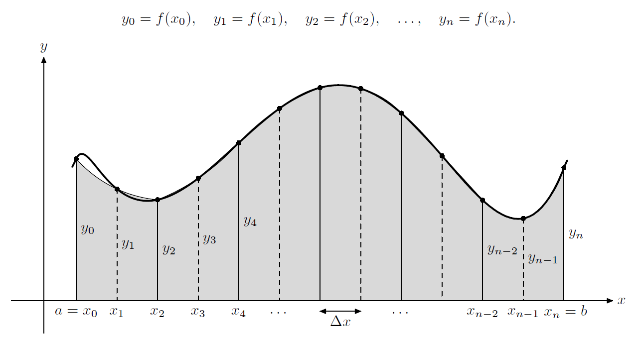

Deriving Simpson's Rule
Interval #1
$$1y_{2}+…)$$

Slide 21
Deriving Simpson's Rule
Interval #2
$$2y_{2}+4y_{3}+1y_{4}…)$$

Slide 22
Deriving Simpson's Rule
Interval #3
$$2y_{2}+4y_{3}+2y_{4}+4y_{5}+1y_{6}+…)$$

Slide 23
Deriving Simpson's Rule
Interval
# n

Slide 24
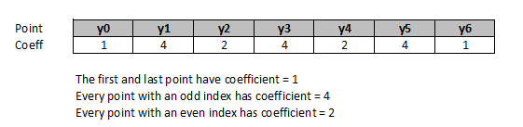
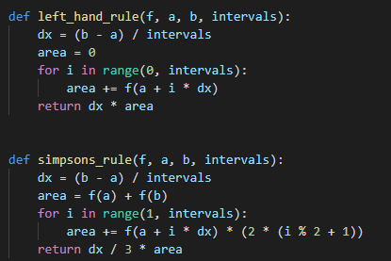
Deriving Simpson's Rule
$$a$$
$$b$$

Slide 25
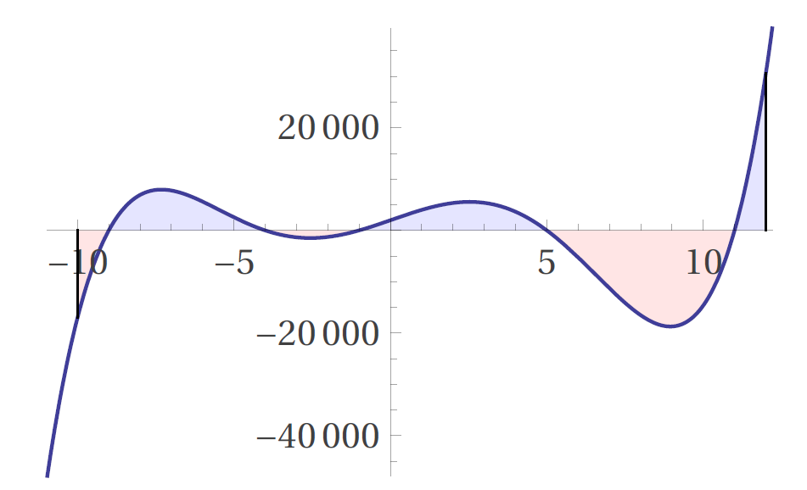

Using Simpson's Rule
$$F\left(x\right)=\int{x^{5}−{2x}^{4}−120x^{3}+22x^{2}+2119x+1980ⅆx}$$
$$(x+9)(x+4)(x+1)(x−5)(x−11)$$

Slide 26
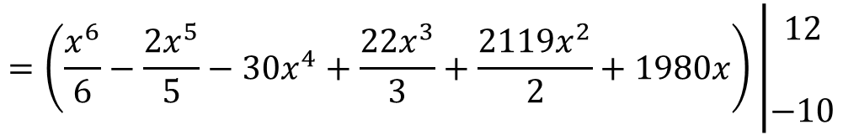
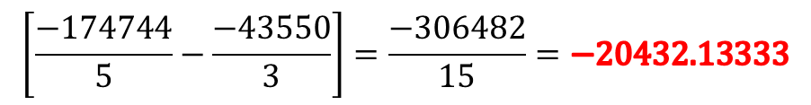
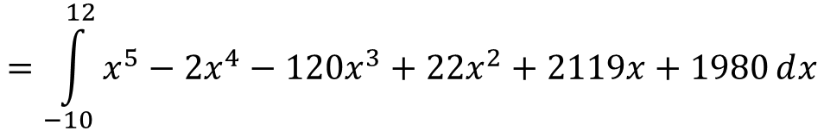
Using Simpson's Rule
$$=\int_{−10}^{12}{x^{5}−{2x}^{4}−120x^{3}+22x^{2}+2119x+1980ⅆx}$$
$$=\left(\frac{x^{6}}{6}−\frac{2x^{5}}{5}−30x^{4}+\frac{22x^{3}}{3}+\frac{2119x^{2}}{2}+1980x\right)\left|\begin{matrix}12 \\ \\ −10\end{matrix}\right.$$
$$\left[\frac{−174744}{5}−\frac{−43550}{3}\right]=\frac{−306482}{15}=−20432.13333$$

Slide 27
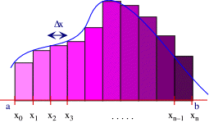
Open simpsons_rule.py
Compare the percent error in the estimate of the integral provided by the left-hand rule vs. Simpson’s rule

Slide 28
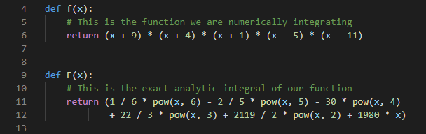
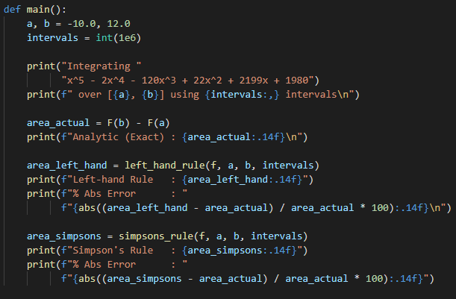
View simpsons_rule.py
In Python we often pass a "function" name as a parameter so a separate function can then call it

Slide 29
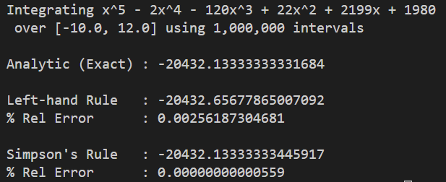
Run simpsons_rule.py
Sometimes dealing with a tiny bit more complexity is more than worth it!

Slide 30
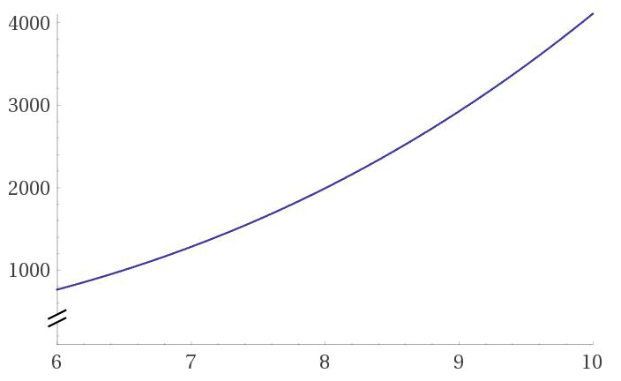
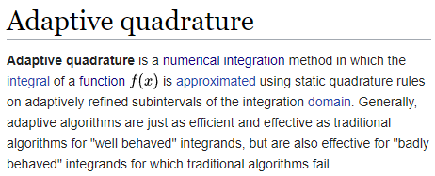

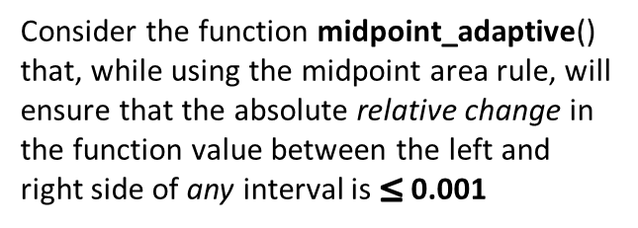
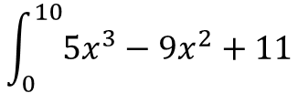


Adaptive Quadrature
Calculate the following integral using the midpoint rule:
$$f\left(x+Δx\right)$$
This large $∆x$ makes
$$\left|\frac{f\left(x+Δx\right)−f\left(x\right)}{f\left(x\right)}\right|$$
exceed the limit
$$\int_{0}^{10}{5x^{3}−9x^{2}+11}$$
$$f\left(x\right)$$
$$Δx$$
Consider the function midpoint_adaptive() that, while using the midpoint area rule, will ensure that the absolute relative change in the function value between the left and right side of any interval is $≤$ 0.001
We need to reduce $∆x$ to keep the absolute relative change in the function value across the interval $≤$ 0.001
The function midpoint_fixed() is set to use 1 million fixed width intervals. How does the midpoint_adaptive() quadrature compare in terms of relative % error and overall execution time?

Slide 31
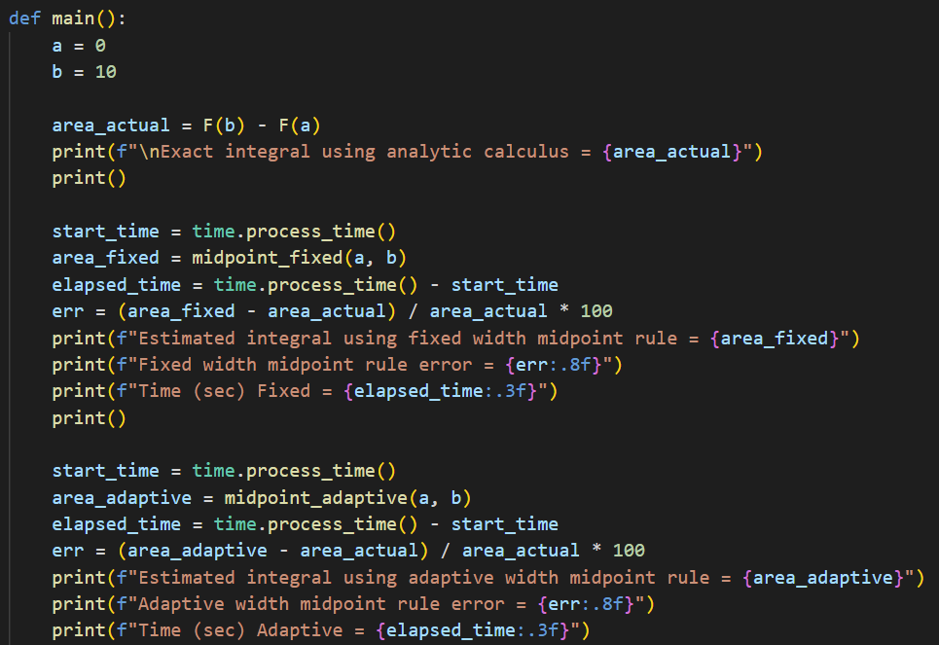

Open adaptive_quadrature.py
①
$$\int_{0}^{10}{5x^{3}−9x^{2}+11}$$
②
③
④
⑤
⑥

Slide 32
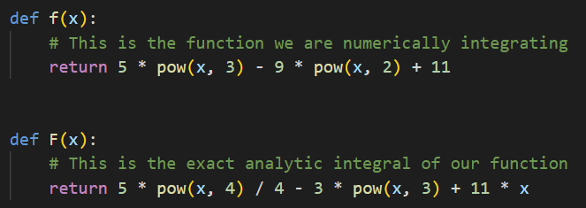
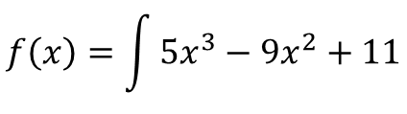


View adaptive_quadrature.py
$$f\left(x\right)=\int{5x^{3}−9x^{2}+11}$$
①
$$F\left(x\right)=\frac{5x^{4}}{4}−3x^{3}+11x$$
②
①
②
$$\int_{0}^{10}{5x^{3}−9x^{2}+11}=9610$$

Slide 33





View adaptive_quadrature.py
①
②
③
$${Δx}_{fixed}$$
$${Δx}_{variable}$$

Slide 34


View adaptive_quadrature.py
①
②
③
④
⑤
⑥

Slide 35

Run adaptive_quadrature.py
Sometimes dealing with a tiny bit more complexity is more than worth it!

Slide 36


Area of a Unit Circle
Estimate the area of a unit circle centered at the origin
using this integrand based upon its conic section
$$F\left(x\right)=4\int_{0}^{1}{\sqrt{1−x^{2}}ⅆx}$$

Slide 37





$$F\left(x\right)=4\int{\sqrt{1−x^{2}}ⅆx}$$
$$F\left(x\right)=2\left(x\sqrt{1−x^{2}}+\sin^{−1}\left(x\right)\right)+C$$
$$4\int_{0}^{1}{\sqrt{1−x^{2}}ⅆx}$$
$$F\left(0\right)=2\left(0\sqrt{1−0^{2}}+\sin^{−1}\left(0\right)\right)=0$$
$$F\left(1\right)=2\left(1\sqrt{1−1^{2}}+\sin^{−1}\left(1\right)\right)$$
$$F\left(1\right)=2\left(\frac{π}{2}\right)=π$$

Slide 38

Open circle_area.py
①
②
③
④

Slide 39

View circle_area.py
①

Slide 40

https://www.scipy.org

Slide 41


https://www.scipy.org

Slide 42

View circle_area.py
①
②
③
④
⑤
⑥

Slide 43

Run circle_area.py
SciPy uses an adaptive higher-order Gaussian quadrature

Slide 44
Completing What Square?
$$ax^{2}+bx+c=0$$
$$ax^{2}+bx=−c$$
$$\frac{1}{a}\left(ax^{2}+bx\right)=\frac{1}{a}\left(−c\right)$$
$$x^{2}+\frac{b}{a}x=\frac{−c}{a}$$

Slide 45

Completing What Square?
$$x^{2}+\frac{b}{a}x=\frac{−c}{a}$$

Slide 46

Completing What Square?
That square!

Slide 47

Completing What Square?

Slide 48


Cumulative Distribution Function
Estimate the probability that a normally distributed random variable will fall within $±$ the first standard deviation $\left(σ\right)$ of its mean $\left(μ\right)$
The integral (the area under the curve) of a probability distribution function (PDF) indicates the probability an observation will fall within that interval
Assume we have a standard normal distribution for this problem

Slide 49




Open stdnormal_area.py
Using the scipy quadrature function, estimate the area under the standard normal curve
from $−1$ to $1$
①
②
$$f\left(x\right)=\frac{1}{σ\sqrt{2π}}e^{\frac{−{\left(x−μ\right)}^{2}}{2σ^{2}}}$$
③
④
Is this area the same as the probability of a normally distributed random variable falling within the first standard deviation away from the mean?
For a standard normal distribution,
$μ=0$ and $σ=1$

Slide 50

Run stdnormal_area.py
Estimate the probability that a normally distributed random variable will fall within $±$ the first standard deviation $\left(σ\right)$ of its mean $\left(μ\right)$

Slide 51

Dirichlet's Pathological Function
The Dirichlet function is defined as
$$f\left(x\right)=\lim_{k→∞}\left\{\lim_{n→∞}\left[{\cos\left(k!∙πx\right)}^{2n}\right]\right\}$$
Using the mpmath package for Python (https://mpmath.org/doc/current) calculate and display the values $f\left(2\right), f\left(2.5\right), f\left(\sqrt{2}\right),f(e)$
You will need to use the mpmath.power(), mpmath.cos(), and the mpmath.factorial() functions, along with the mpmath.pi constant
Hint: watch a video on the Dirichlet function, such as https://www.youtube.com/watch?v=LeGWPuRdetM

Slide 52


Open dirichlet_function.py
①
②
④
⑤
$$f\left(x\right)=\lim_{k→∞}\left\{\lim_{n→∞}\left[{\cos\left(k!∙πx\right)}^{2n}\right]\right\}$$
⑥
⑧
https://mpmath.org/doc/current/general.html#chop
⑦
③
⑨
⑩

Slide 53


Run dirichlet_function.py

Slide 54

Real Analysis
Riemann Integral
Lebesgue Integral

Slide 55

Session 10 – Know You Know…
We can numerically estimate a first derivative using Fermat's Difference Quotient and higher-order derivatives using Newton's Difference Quotient
$$f^{\left(n\right)}\left(x\right)=\lim_{h→0}{\frac{1}{h^{n}}\sum_{k=0}^{n}{{\left(−1\right)}^{k+n}}\left(\begin{matrix}n \\ k\end{matrix}\right)f\left(x+kh\right)}$$
Using Simpson's Rule provides better estimates for most integrands because it fits a parabola to the top of the interval to better match a curving function
The adaptative quadrature approach gains greater accuracy in regions of high rates of change and gains speed across relatively flat regions versus using fixed width intervals

Slide 56
Session 10 – Know You Know…
The SciPy Integration sub-package, with its quad() function, provides a highly efficient and accurate numerical integrator
The integral of the PDF for the Standard Normal distribution between -1 to 1 is the same as the probability a random variable will fall within one standard deviation
Pathological functions like Dirichlet's demonstrate the nowhere continuous property but have a Lebesgue measure of zero – the Weierstrass function is everywhere continuous but nowhere differentiable

Slide 57

Task 10-01
Create a Python program called ladder_problem.py that uses SciPy to calculate and display the maximum ladder length possible that will fit around the corner depicted on the next slide
Additionally, using pyplot, graph the function describing the maximal ladder length as a function of $θ$ (see following diagram)
Finally, plot the point where this function has a zero rate of change
Upload your solution to the BNL QIS101 SharePoint site

Slide 58



Task 10-01
$$C_{2}=1m$$
What is the maximum length straight ladder than can fit around this corner?
Note: the ladder must always maintain a constant length
$$C_{1}=2m$$
$$θ$$

Slide 59

Task 10-02
Create a Python program called archimedes_spiral.py that uses SciPy to calculate and display the arc length of an Archimedes Spiral with $r=θ$ as it rotates from $0≤θ≤8π$
Using pyplot, graph that entire spiral
Upload your solution to the BNL QIS101 SharePoint site

Slide 60

Task 10-03
Create a Python program called eulers_constant.py that uses SciPy to numerically estimate Euler's Constant:
$$γ=−\int_{0}^{1}{\ln{\ln\left(\frac{1}{x}\right)}ⅆx}$$
Then use pyplot to superimpose a line graph of $γ+\ln\left(x\right)$ on top of a step plot of the first 50 Harmonic Numbers
Upload your solution to the BNL QIS101 SharePoint site

